Slide 1

Turning off TV: A Quiet Hour
四川省双流中学 覃梅
2018.11.07

Slide 2
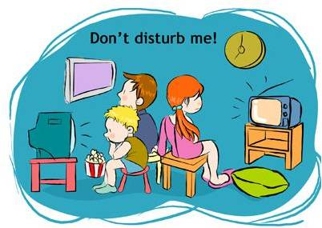
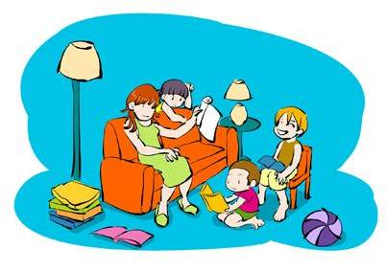
1. Desribe the two pictures.
2. Which one do you prefer?

Slide 3
What function does the first part serve?
(A) Introduction
(B) Describing the proposal in detail
(C) Explaining why the author put forward his proposal
Many people in the United States spend most of their free time watching television. Certainly...

Slide 4
Para 1
What proposal is put forward in the first paragraph?
For 60-90 minutes each evening, all television broadcasting in the US be prohibited by law

Slide 5
    Read the text and summarize the benefits of turning off TV.
Para 2-5
Without TV, People could
1.
2.
3.
4.

Slide 6
    Read the text and summarize the benefits of turning off TV for an hour.
Many of our problems, from the generation gap
to the high divorce rate to some forms of mental
illness are caused ….
Without TV, People could
Take a ride together to watch…
communicate with each other better
___________
1.
Take a walk together
find more active pastimes
___________
2.
See the neighborhood with ….
3.
___________
4.

Slide 7
Freed from TV, forced to find their own activities, they might take a ride together to watch the sunset. Or they might take a walk together (remember feet?) and see the neighborhood wiht fresh , new eyes.
A rhetorical question (反问）: it implies that Americans are now so used to traveling by car or other vehicles that many people almost forget that they can walk to some place.
America is sometimes nicknamed as “a country on wheels”.

Slide 8
    Read the text and summarize the benefits of turning off TV for an hour.
People could
Take a ride together to watch…
communicate with each other better
___________
1.
Take a walk together
find more active pastimes
___________
2.
See the neighborhood with ….
3.
rediscover reading
___________
4.

Slide 9
What could be a product of the quiet hour?
A more literate new generation could be ...
literate= well educated

Slide 10
    Read the text and summarize the benefits of turning off TV for an hour.
Few pastimes bring a family closer together than gathering around and listening to mother or father read a good story.
People could
Take a ride together to watch…
communicate with each other better
___________
1.
Take a walk together
find more active pastimes
___________
2.
See the neighborhood with ….
3.
rediscover reading
___________
4.
read stories aloud

Slide 11
Para 6
1. How long has the TV controlled the Americans’ life?
2. Why does the author think that it might be radical （激进的） to Americans at first glance?
3. What can we infer about the writer’s attitude?

Slide 12
Para 6
2. Why does the author think that it might be radical
to Americans at first glance?
What will parents do without...?
How will we spend the time?
    3. What can we infer about the writer’s attitude?
According to the author watching TV is a
Passive pastime.

Slide 13
Discussion and Debate
Television has been around in the world for several decades, and it is still a controversial topic.
What do you think about watching TV?
Is it an active or passive pastime?
Topic: Is TV a Plus or Minus?

Slide 14
Discussion and Debate
Topic: Is TV a Plus or Minus?
Outline 1 (Argument for) Talk about the advantages of TV Advantages: | Outline 2 (Argument against) Talk about the disadvantages of TV. Disadvantages:
Language Tips: Showing Attitudes
Giving Opinions 1.I’d like to point out… 2.As far as I’m concerned,… 3.In my opinion,… 4.From my point of view, I think… 5.Personally, I think… 6.Frankly, I think… 7.As far as I’m able to judge… 8.The point is…

Slide 15
Discussion and Debate
Topic: Is TV a Plus or Minus?
Outline 1 (Argument for) Talk about the advantages of TV Advantages: a convenient & cheap source of entertainment offering educational programs as well as exciting ones keeping people informed of current events helping people to keep up with developments in science & technology giving a great comfort to lonely old people .... | Outline 2 (Argument against) Talk about the disadvantages of TV. Disadvantages: a totally passive pastime taking up too much time of people’s free time distracting people from their work & study making children nearsighted & otherwise weak physically ...

Slide 16

Assignment
Write down your group’s opinions about the debate

Slide 17
Thanks
for your COORPERATION！

